Slide 1
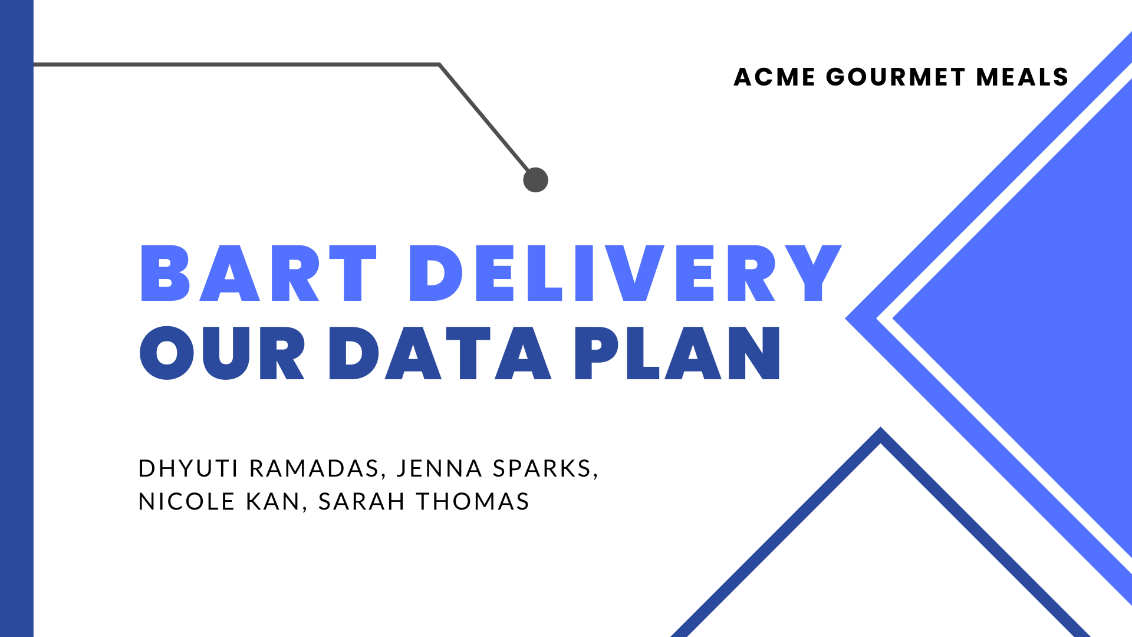
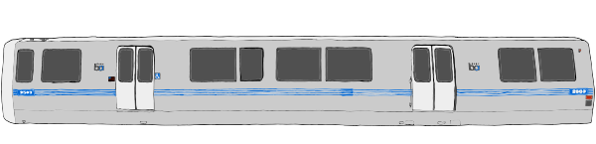
Notes:
Jenna:
We are eager to present our ideas to the data science team. Our presentation will focus on NoSQL databases that will be used to accomplish our business goal of increasing delivery services and specifically using public transportation to achieve this goal.
In this presentation, our data engineering team will discuss using Bart as a delivery tool and the computational tools we will use to smoothly implement this plan

Slide 2
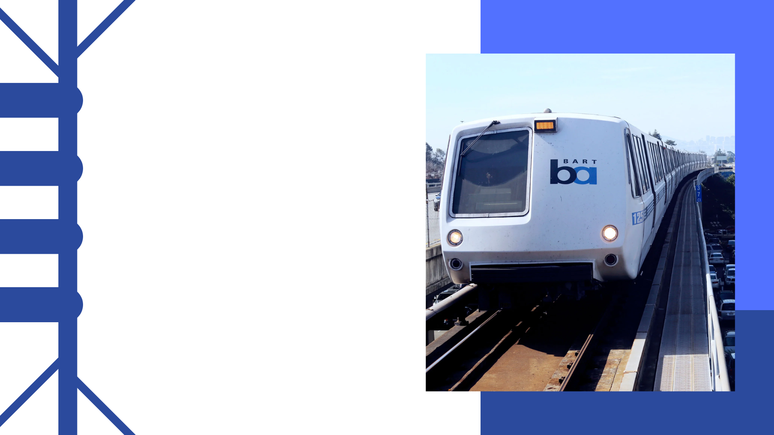
Our Objectives
1
Use BART for delivery
2
Add pick-up spots
3
Make delivery efficient
4
Make delivery cost effective
Notes:
In order to expand our delivery services we intend to do the following:
Use BART for delivery
Add pick-up locations at various BART stations
And Have delivery be efficient and cost effective

Slide 3

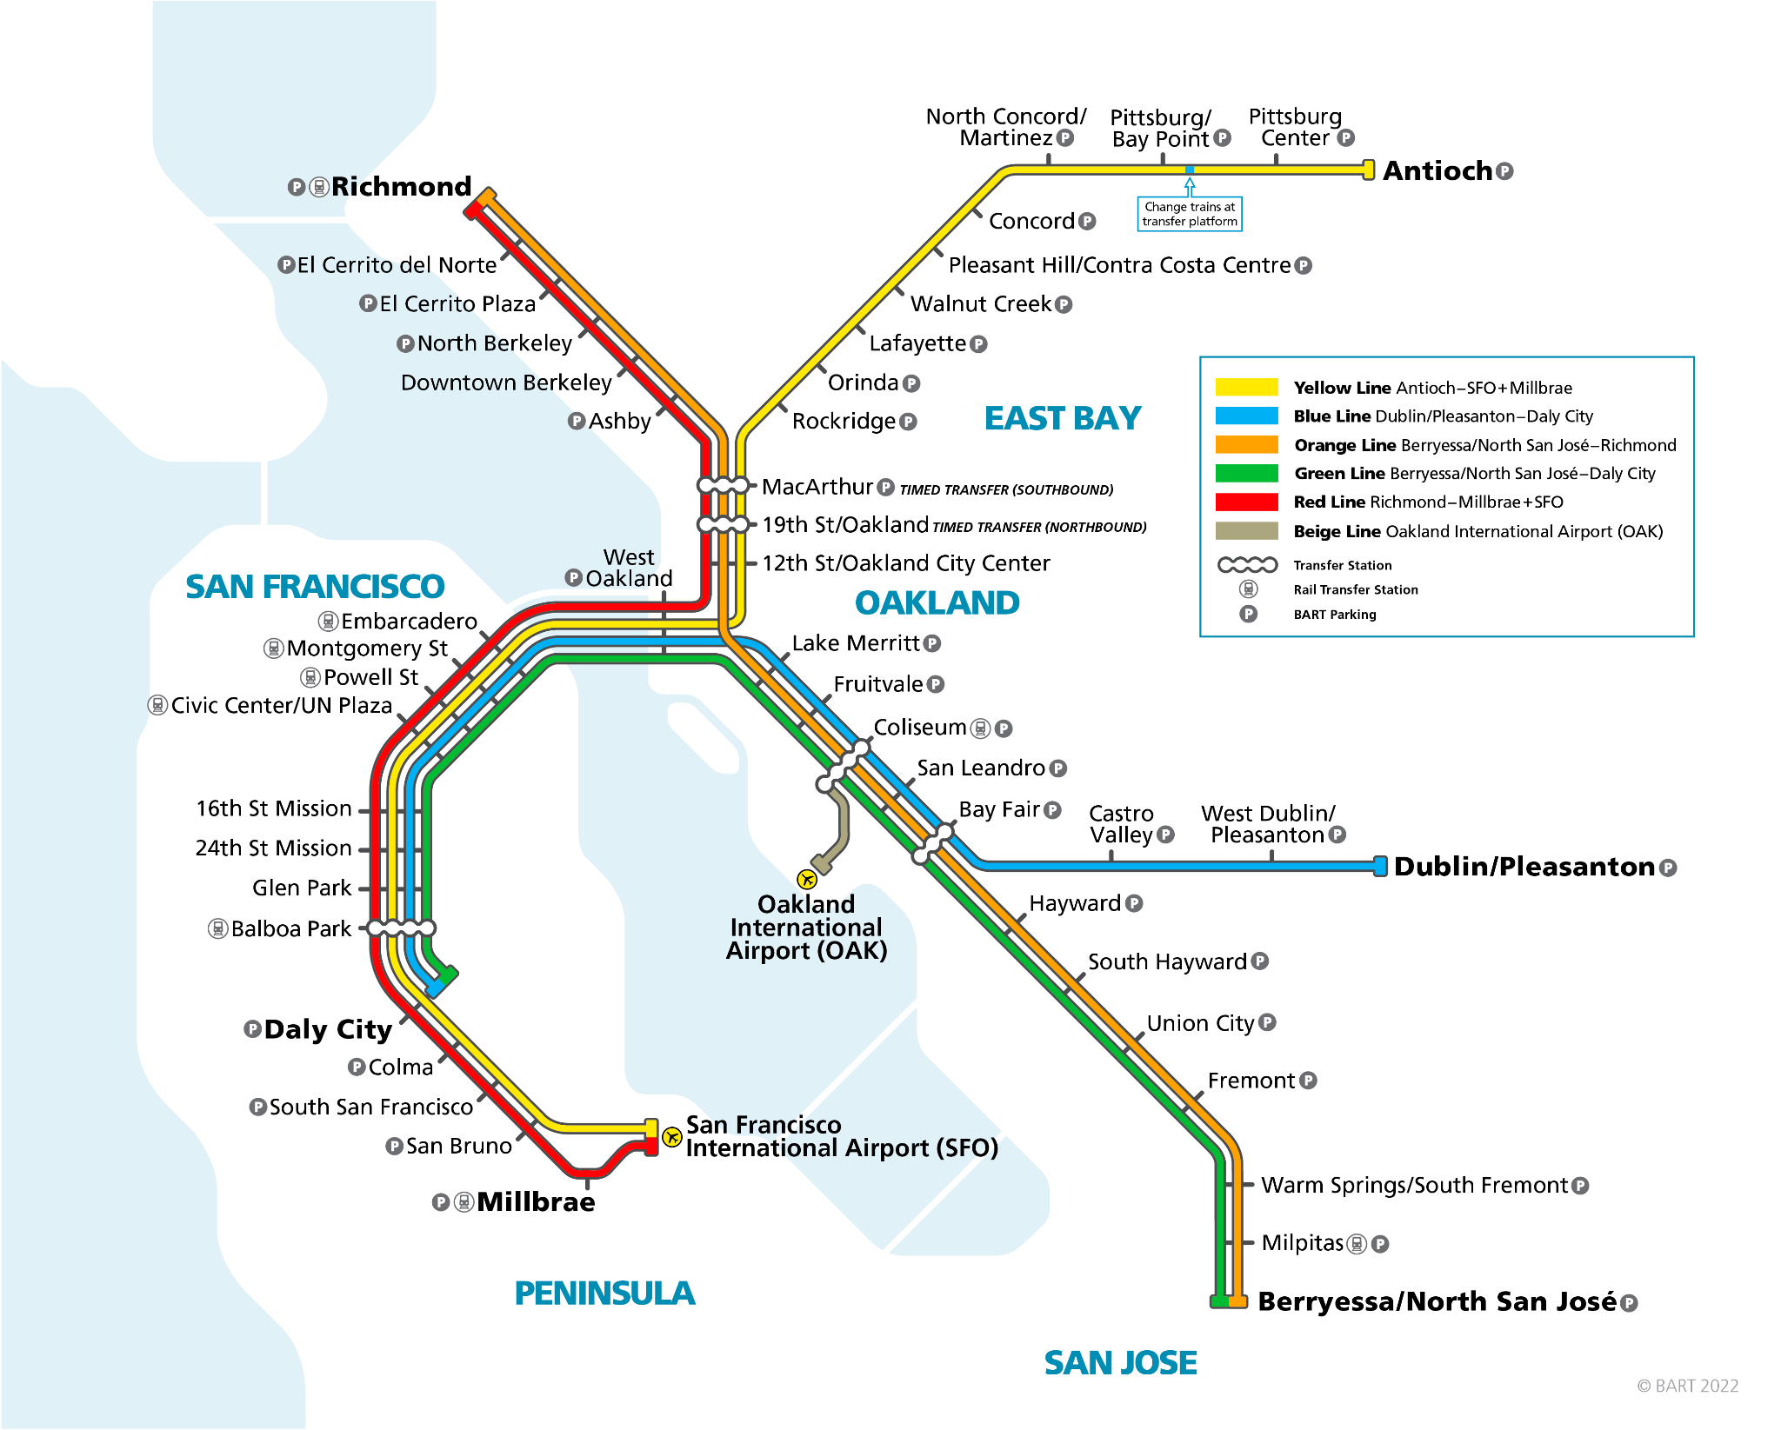
BART MAP
Notes:
Sarah
We feel that using public transportation for delivery benefits both us and BART.
For us:
It allows us to Save money on maintenance of our own delivery vehicles
And we can Avoid gridlock traffic which is becoming more prevalent in the Bay Area
For BART:
This would mean more ridership which in turn would mean more funding.

Slide 4

NoSQL Databases
1
Neo4j
2
Mongo DB
3
Redis
Notes:
Sarah
To accomplish our objectives we will be using NoSql databases such as

Slide 5


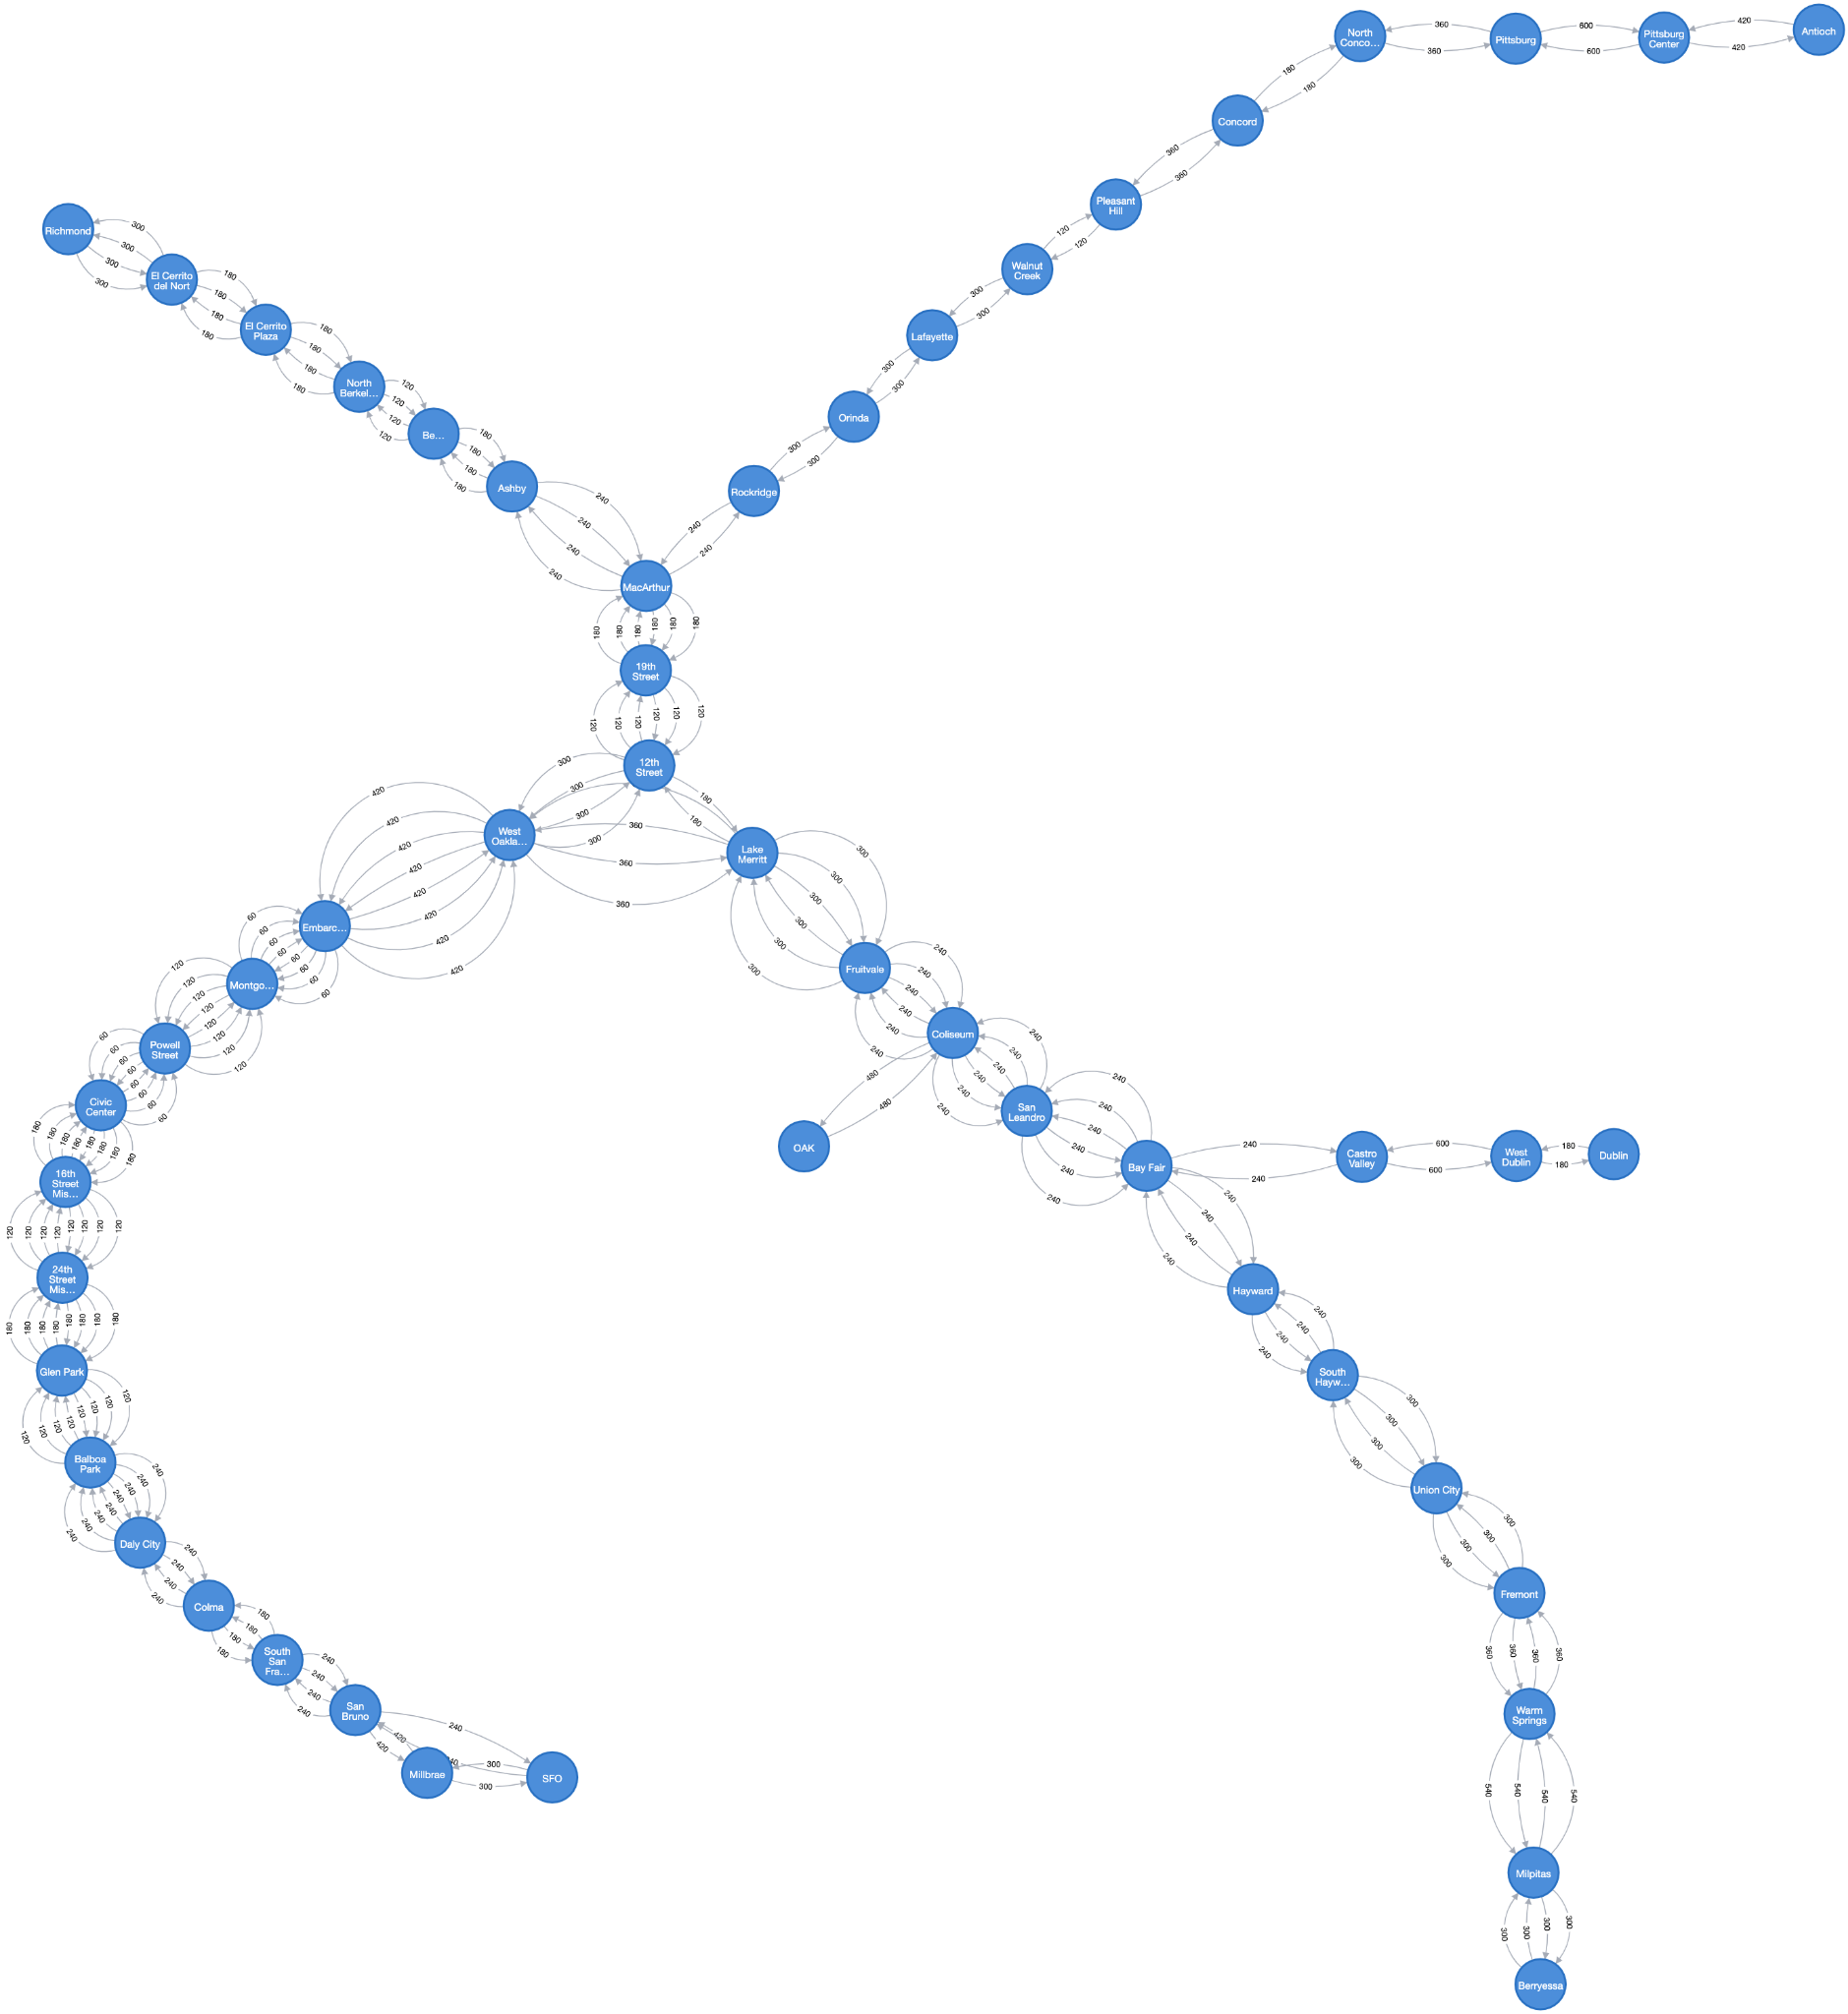
Notes:
Neo4j
Great for handling graph data like our delivery route data! We shaped it according to the BART map , we can see it overlaid here (SLIDE CHANGE)

Slide 6

Notes:
Why not relational database:
Neo4j is specifically designed for graph data vs not relational database
Neo4j is more easily scalable when we add more to our delivery methods like if we want to add drones and trucks in future
(SLIDE CHANGE)

Slide 7
Betweenness Centrality
Harmonic Centrality
name | betweenness
MacArthur | 1176
12th Street | 1116
19th Street | 1088
Lake Merritt | 1020
Fruitvale | 980
West Oakland | 980
Coliseum | 960
Embarcadero | 936
Montgomery Street | 888
Powell Street | 836
name | closeness
12th Street | 0.233302
Lake Merritt | 0.231867
West Oakland | 0.228991
MacArthur | 0.226052
19th Street | 0.219525
Coliseum | 0.216537
Fruitvale | 0.214852
Bay Fair | 0.209259
Embarcadero | 0.204956
San Leandro | 0.204085
Notes:
We measured betweenness and harmonic centrality
Betweenness - shortest paths in the graph that pass through this node
Harmonic - closeness to other nodes, shortest amount of time to travel
(SLIDE CHANGE)

Slide 8
Betweenness Centrality
Harmonic Centrality
Name | Betweenness
MacArthur | 1176
12th Street | 1116
19th Street | 1088
Lake Merritt | 1020
Fruitvale | 980
West Oakland | 980
Coliseum | 960
Embarcadero | 936
Montgomery Street | 888
Powell Street | 836
Name | Closeness
12th Street | 0.233302
Lake Merritt | 0.231867
West Oakland | 0.228991
MacArthur | 0.226052
19th Street | 0.219525
Coliseum | 0.216537
Fruitvale | 0.214852
Bay Fair | 0.209259
Embarcadero | 0.204956
San Leandro | 0.204085
Notes:
Several common stations with high betweenness and harmonic centrality. Can be considered pickup points for customers.
High centrality indicates that the station plays a crucial role in the flow of traffic between other stations, making it an essential stop for the delivery service to reach a wide range of destinations.
Top stations are macarthur, 12th, 19th which make sense because they are centrally located (SLIDE CHANGE)

Slide 9
Notes:
Here are the locations of the highest ranking stations (SLIDE CHANGE)

Slide 10
Notes:
This makes sense because they are very centrally located. We can see the same stations that ranked highly on centrality scores here. (SLIDE CHANGE)

Slide 11
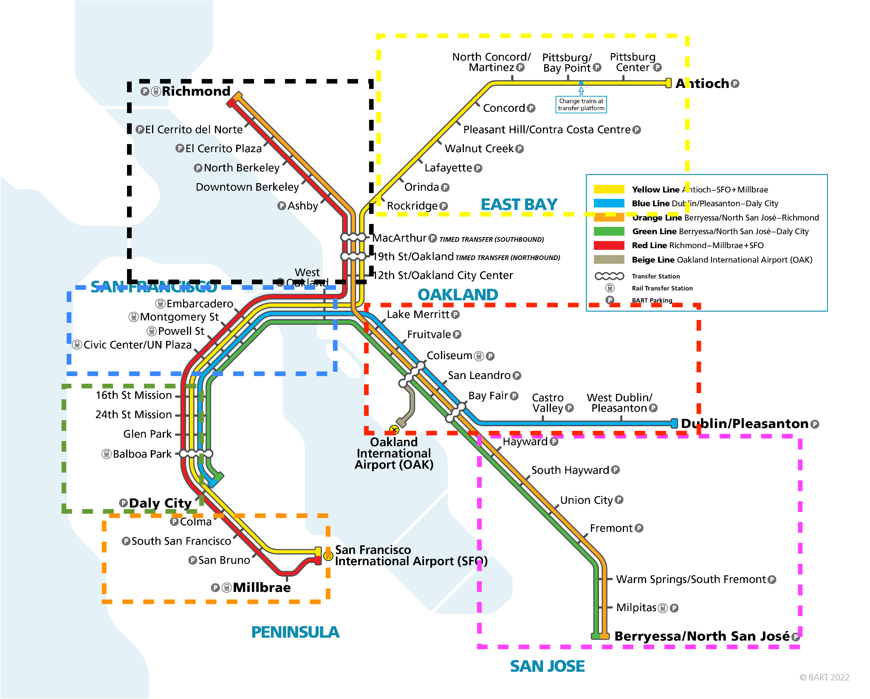
Community Detection Algorithm - Louvain Modularity
7 Communities Detected:
Notes:
7 Communities were detected through Louvain Modularity
Richmond, Antioch, Dublin/Pleasanton, Berryessa North San Jose lines are 4 communities
SFO/Milbrae line is divided into 3 communities

Slide 12
Sorted & Ranked Results by Community
Community | Highest average of people exiting (June) | Largest population within 1 mile | Highest Harmonic Centrality | Highest Betweenness Centrality
Civic Center, Embarcadero, Montgomery, Powell, West Oakland | 1. Embarcadero 2. Montgomery Street | 1. Civic Center 2. Powell | 1. West Oakland 2. Embarcadero | 1. West Oakland 2. Embarcadero
Colma, San Bruno, South San Francisco, Millbrae, SFO | 1. SFO 2. Millbrae | 1. South San Francisco 2. Colma | 1. Colma 2. South San Francisco | 1. Colma 2. South San Francisco
Coliseum, Bay Fair, Fruitvale, Lake Merritt, San Leandro, Castro Valley, West Dublin, Dublin, OAK | 1. Fruitvale 2. Coliseum | 1. Lake Merritt 2. San Leandro | 1. Lake Merritt 2. Coliseum | 1. Lake Merritt 2. Fruitvale
Fremont, Milpitas, Union City, Warm Springs, Berryessa, Hayward, South Hayward | 1. Hayward 2. Fremont | 1. Berryessa 2. Union City | 1. Hayward 2. South Hayward | 1. Hayward 2. South Hayward
Concord, Lafayette, North Concord, Orinda, Pittsburg, Pittsburg Center, Pleasant Hill, Rockridge, Walnut Creek, Antioch | 1. Walnut Creek 2. Rockridge | 1. Rockridge 2. Pittsburg Center | 1. Rockridge 2. Orinda | 1. Rockridge 2. Orinda
16th street, 24th street, Glen Park, Balboa Park, Daly City | 1. 16th Street 2. 24th Street | 1. 16th Street 2. 24th Street | 1. 16th Street 2. 24th Street | 1. 16th Street 2. 24th Street
12th street, 19th street, MacArthur, Ashby, Downtown Berkeley, El Cerrito Plaza, El Cerrito del Norte, North Berkeley, Richmond | 1. Downtown Berkeley 2. 12th Street | 1. 12th Street 2. Ashby | 1. 12th Street 2. MacArthur | 1. MacArthur 2. 12th Street
Notes:
When considering future BART pick up locations for meal delivery, we wanted to consider a few factors :
Average number of people exiting the station : The higher the number, the more traffic and utilization of the station thus making it a convenient pickup location
Population within 1 mile of the station: The idea is that a location with larger population within 1 mile of the station serve as a great pickup location for people who live close and for commuters who lives close to the station and take BART frequently
Harmonic centrality: A high harmonic centrality indicates the station has a shorter average travel times to all other stations in the network which making a vital hub. We would want to select pickup locations that have high harmonic centrality and is well connected and efficiently accessible to many other stations, reducing the travel time and costs needed for meal deliveries
Betweenness centrality: A high betweenness centrality indicates that the station serves as a critical connector between many routes and plays a crucial role in the flow of traffic between other stations, making it an essential stop for the delivery service to reach a wide range of destinations.
We wanted to utilize the results from Louvain Modularity to assign pickup locations through SF bay area. We try to diversify our pick up locations so that each community or each BART line has at least one location.
Here are the stations that are potential great candidates:
Embarcadero : It has the highest average number of people exiting the station in the map and very high harmonic and betweenness centrality. This station is right at SF downtown and it is no surprise that there is a high amount of traffic from commuters, making it a great meal pickup spot
16th Street, Hayward and 12th Street have the highest average number of people exiting the station and also ranked the highest on harmonic and betweenness centrality in their respective community, thus they make great pickup spots
South SF, Lake Merritt and Rockridge are stations with the highest number of population within 1 mile of the station and have a high ranking of harmonic and betweenness centrality in their respective community

Slide 13
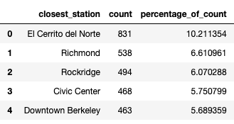
Closest BART Station for Existing Customers
8138 Customers records based in CA
Top 5 Stations with the highest number of existing customer count : El Cerrito del Norte, Richmond, Rockridge, Civic Center and Downtown Berkeley
Top 5 Stations contributed to ~34% of total count of existing customers based in CA
Centered in East Bay (Richmond and Antioch Lines)
Notes:
We also pulled in the closest BART station for the existing customers
There are 8134 customer records based in CA
We found that the top 5 stations with the highest number of current customers count are El Cerrito del Norte, Richmond, Rockridge, Civic Center and Downtown Berkeley
The top 5 stations contributed to 34% of the customers based in CA and they are mostly located closest to the stations in East Bay especially the Richmond and Antioch lines

Slide 14

Future Pick Up Locations
High Potential Locations for Business Expansion
Stations Closest to Existing Customers
Notes:
High Potential for Business Expansion:
At least 1 pickup location per community and color line
Covers SF downtown, Peninsula area, East Bay and North of SF downtown
Target stations with highest number of people exiting for commuters
Target stations with larger population within 1 mile of station for pickup convenience and opportunities for future business expansion
Harmonic Centrality results are factored in to determine how quickly deliveries can be completed and the cost associated
Better Serve Existing Customers:
Consider the top 5 stations closest stations such as El Cerrito del Norte which contributes to 10% of the customer base

Slide 15

Example: Delivery from Berkeley store to Rockridge
Fastest Routes:
Downtown Berkeley (Red) → MacArthur (Yellow) → Rockridge
Downtown Berkeley (Orange) → MacArthur (Yellow) → Rockridge
Store Location
Delivery Location
Notes:
Sarah
Now we are going to discuss the databases that are not graph based.
The first of which is Mongo DB.
With mongo db we can store precomputed BART delivery routes.
Therefore it will be easier to save the Shortest routes / least costly
As seen in the example on the slide, if we are delivering from the store to Rockridge (one of our possible pick-up locations), the shortest route would be ____ and you could take the red or orange line from ______.
better than a relational database:
Using this nosql database would mean that we wont have to compute delivery routes in real time
Additionally, Mongo can store complex delivery routes better
And is better at scaling up
As it allows for Horizontal scalability (scale across multiple nodes),
These features make it easier to update delivery routes especially if BART is expanded in the future or if we decide to incorporate other delivery methods such as truck or drone delivery.

Slide 16
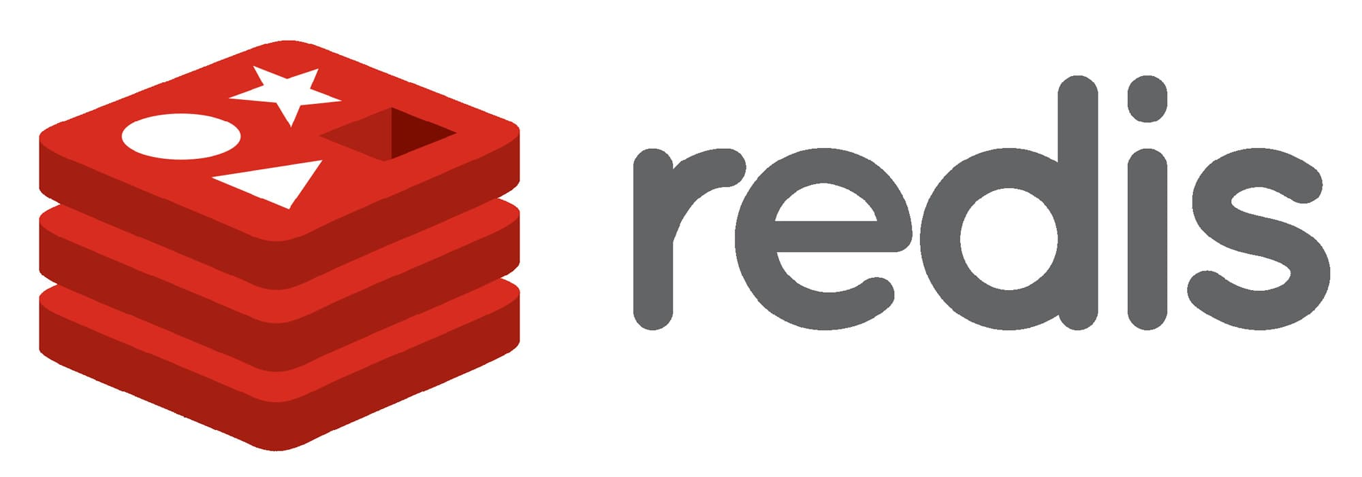
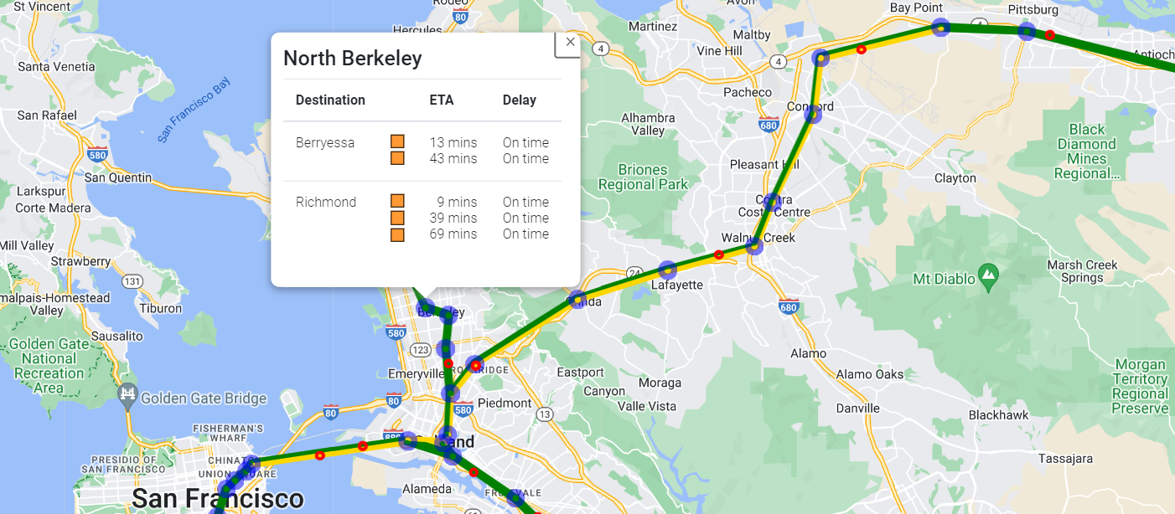
Notes:
Jenna:
For our delivery plan we will use redis to:
Store real-time BART data
This will help us to inform customers about delivery status and avoid confusion
For example messages to customers could include: trains arriving early, delayed, or cancelled
It will be good to use Redis, a NoSQL database, rather than a relational database:
In-memory storage of Redis allows for quicker computations as traffic changes

Slide 17

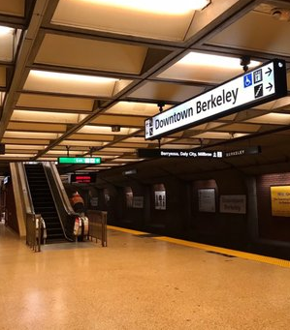
Conclusion
NoSQL databases can help us utilize BART for deliveries
Neo4j
Delivery locations
MongoDB
Pre-computed routes
Redis
Train status in real-time
Notes:
Jenna:
In conclusion, these NoSQL databases can benefit our objective to use Bart for deliveries
Neo4j centrality algorithms will help us cater to existing customers while also allowing us to establish viable options for successful future delivery locations
Neo4j community detection algorithms will also help us to discern potential customer “hot spots”
With our delivery plan mapped out in the Neo4j algorithms, we can use MongoDB to store pre-computed routes that get our deliveries to our customers in a time efficient manner
When our BART plan is successful, we can scale up easily with MongoDB
Additionally, Redis’ in-memory storage will allow us to produce real-time data of train status
Adopting and utilizing these NoSQL databases will allow us to smoothly implement our Bart delivery plan
Thank you for your time. Does anyone have any questions?

Slide 18
Questions?

Slide 19

Resources
https://www.bart.gov/about/reports/ridership
https://aaroncohen.github.io/barttraffic/

